Slide 1


REVOLUTIONIZING HR OPERATIONS WITH ADVANCED AUTOMATION
PIYUSH KUMAR
----------------------------------
1 / 5
01 AUGUST, 2025

Slide 2
Current HR Challenges
Manual resume screening takes 23 minutes per candidate
67% of recruiters struggle with candidate matching
Average time-to-hire: 35+ days
Email communication is scattered across multiple tools
No centralised template or job description management
The Need: Intelligent, Automated HR Solution
Problem
Statement
2 / 5

Slide 3
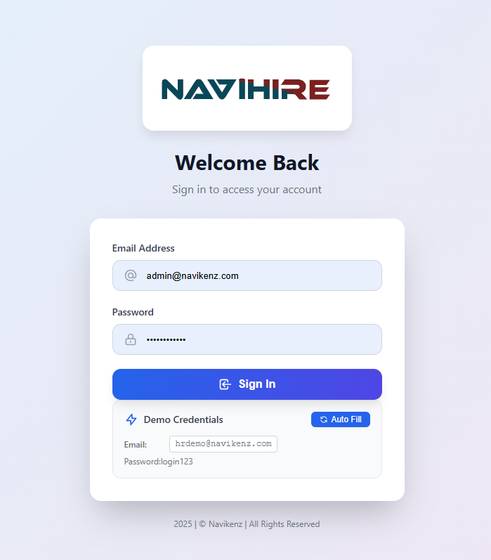
Solution Overview
NaviHire: Complete HR Automation Suite
AI-Powered Candidate Matching
Intelligent Email Automation
Smart Template Management
Advanced Scheduling System
Real-time Analytics Dashboard
"From Resume to Hire in Minutes, Not Days"
3 / 5

Slide 4

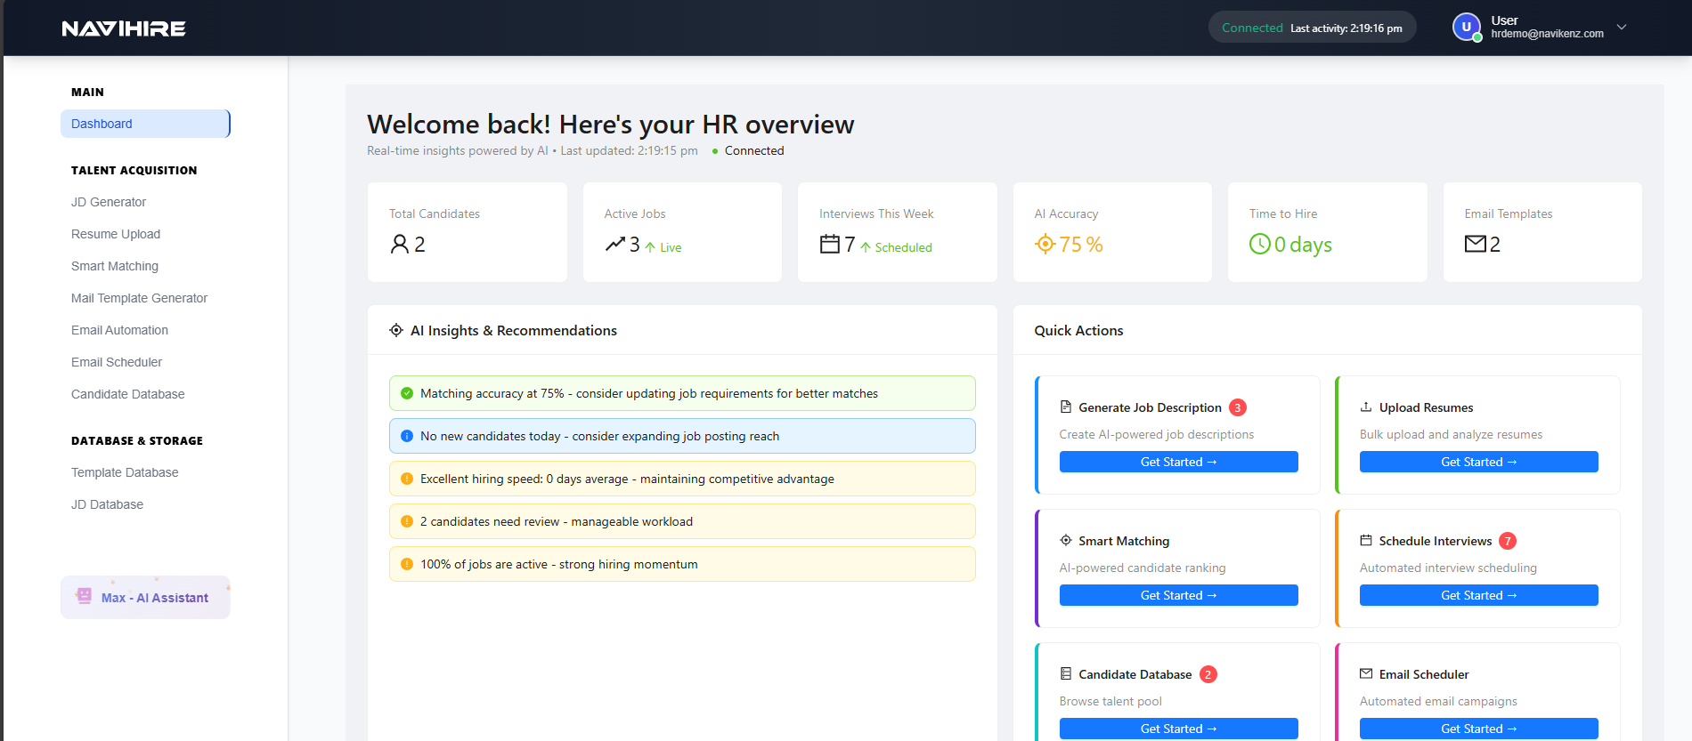
Core Features & Demo
4 / 5

Slide 5
Thank You

